Slide 1
CIS 5525: Neural Computation
Topic: Graph Neural Networks
Instructor: Kai Zhang
CIS @ Temple University, Spring 2020

Slide 2
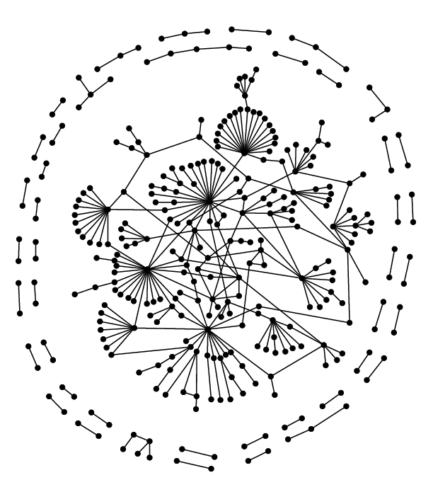
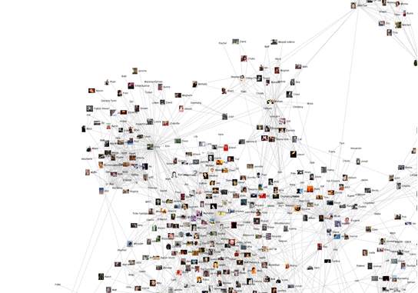
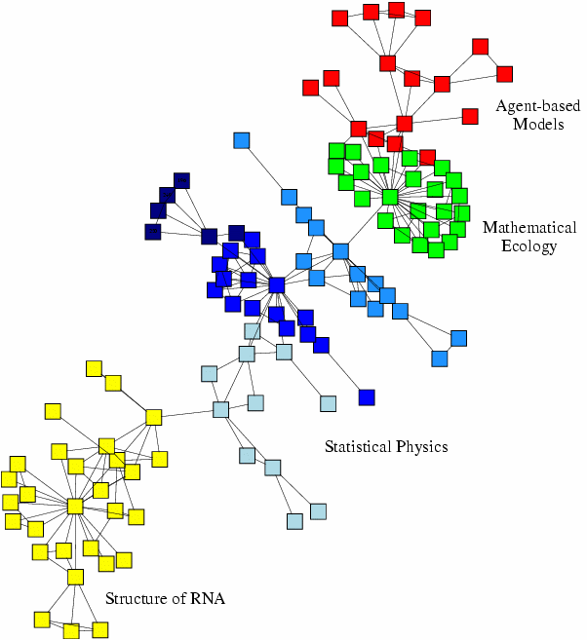
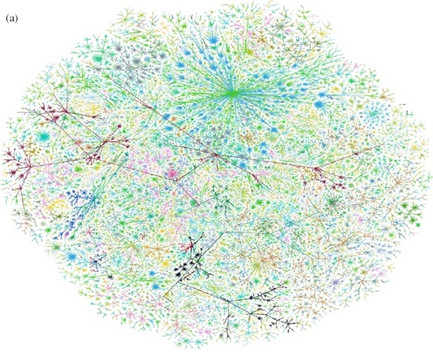
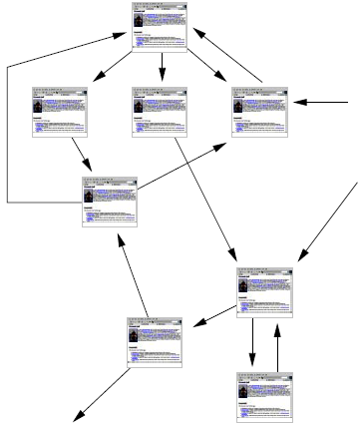
Graph-structured data
Social networks
Economic networks
Biomedical networks
Information networks: Web & citations
Internet
Networks of neurons

Slide 3
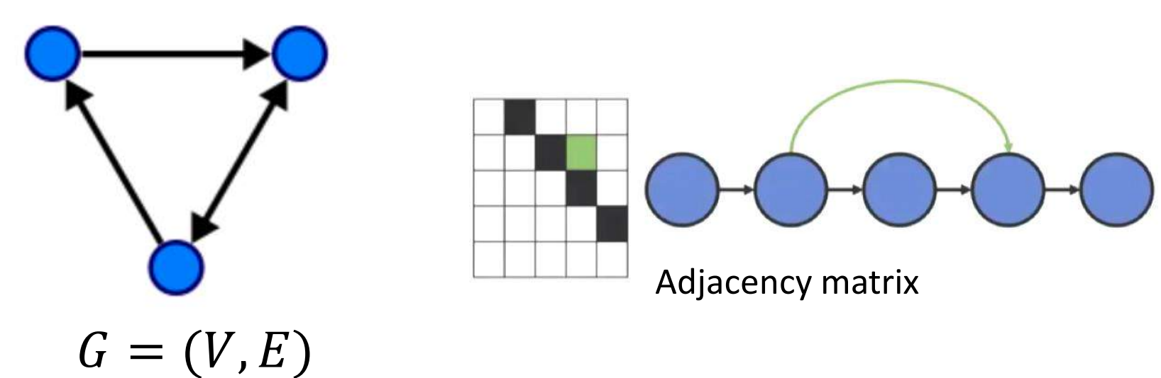
Graph-structured data
A graph G can be well described by the set of vertices V and edges E it contains: G = (V,E).
Edges can be either directed or undirected, depending on whether there exist directional dependencies between vertices.
Directed edges -> asymmetric Adjacency matrix
Undirected edges -> symmetric Adjacency matrix
The vertices are often called nodes.

Slide 4
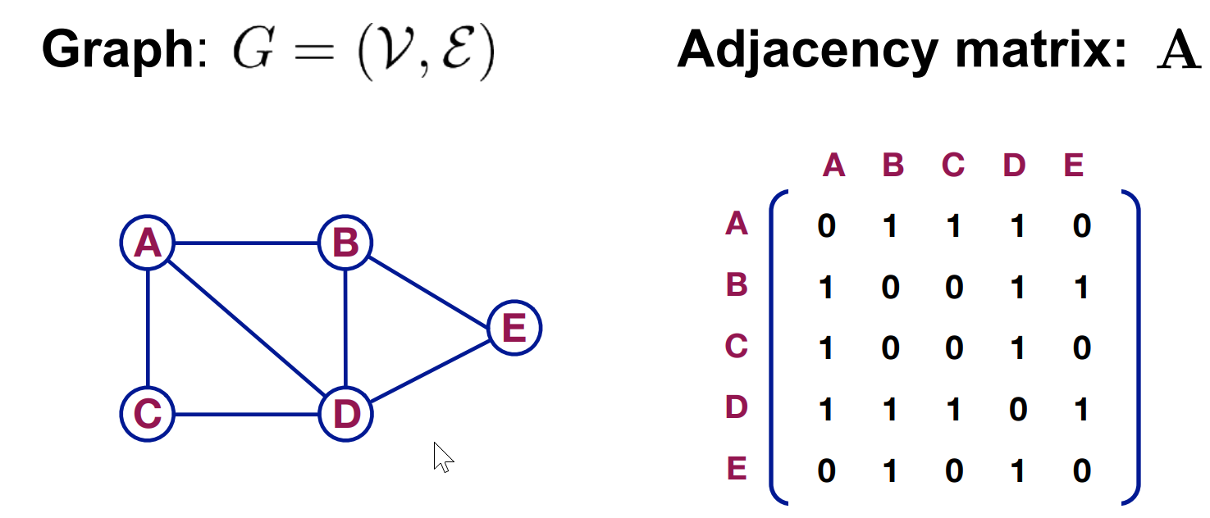
Graph-structured data

Slide 5
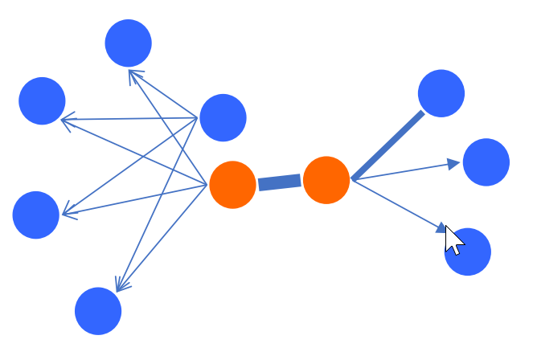
First order neighbors
The local pairwise proximity between the nodes
Direct link as signified by adjacency matrix A
However, many long range connections ignored
Not sufficient for preserving the entire network structure
First-order neighbor

Slide 6
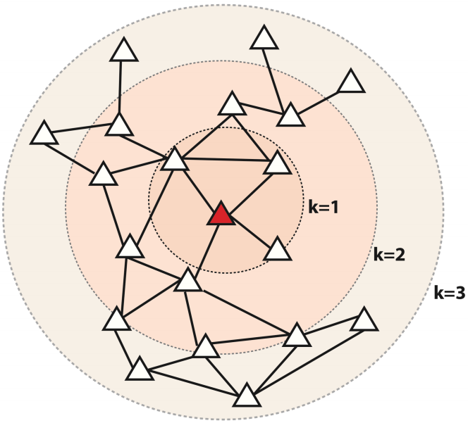
Multi-hop Neighbors
Red: Target node
k=1: 1-hop neighbors
A (i.e., adjacency matrix)
k= 2: 2-hop neighbors
k=3: 3-hop neighbors

Slide 7
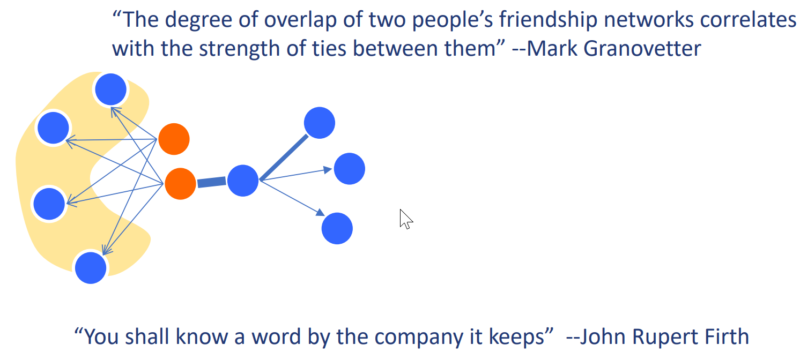
High-order similarity
Contextualize each node by its neighbors
High-order proximity relation matrix
Example: power of the adjacency matrix A^k
B(i,j) = A(i, : ) * A(: , j)
B = A*A

Slide 8
Graph-related Learning Tasks
Classical ML tasks in networks:
Node classification
Predict a type of a given node
Link prediction
Predict whether two nodes are linked
Community detection
Identify densely linked clusters of nodes
Network similarity
How similar are two (sub)networks

Slide 9
Example: Node Classification/Embedding
?
?
?
?
Machine Learning
?

Slide 10
Node Classification Example
Classifying the function of proteins in the interactome!
Image from: Ganapathiraju et al. 2016. Schizophrenia interactome with 504 novel protein–protein interactions. Nature.

Slide 11
Node Embedding Example
Node embedding

Slide 12
Example: Link Prediction
?
?
x
?
Machine Learning

Slide 13




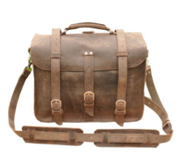



Link Prediction Example
Content recommendation is link prediction!
?

Slide 14
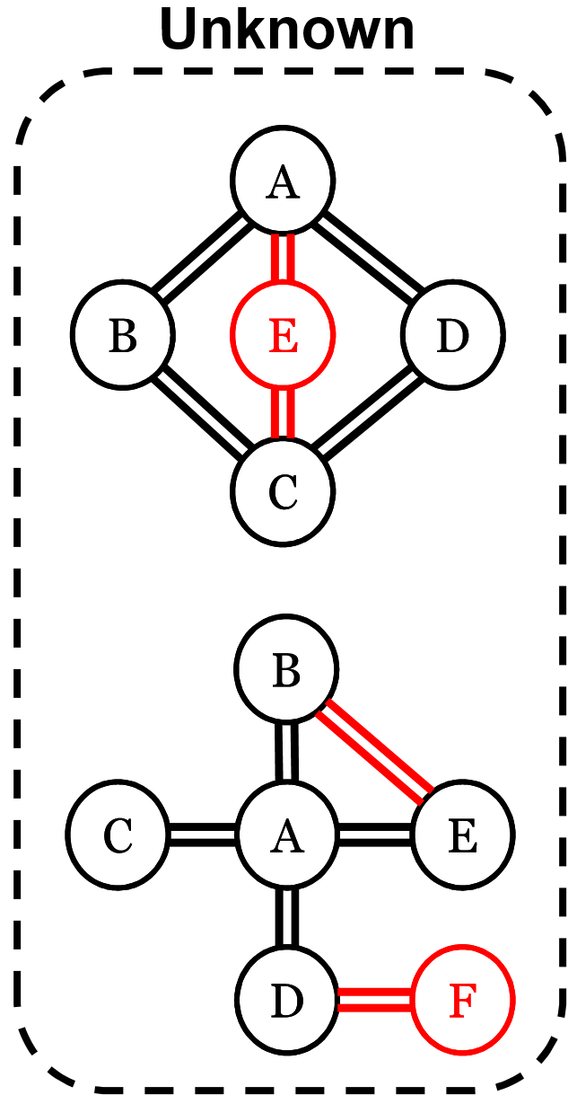
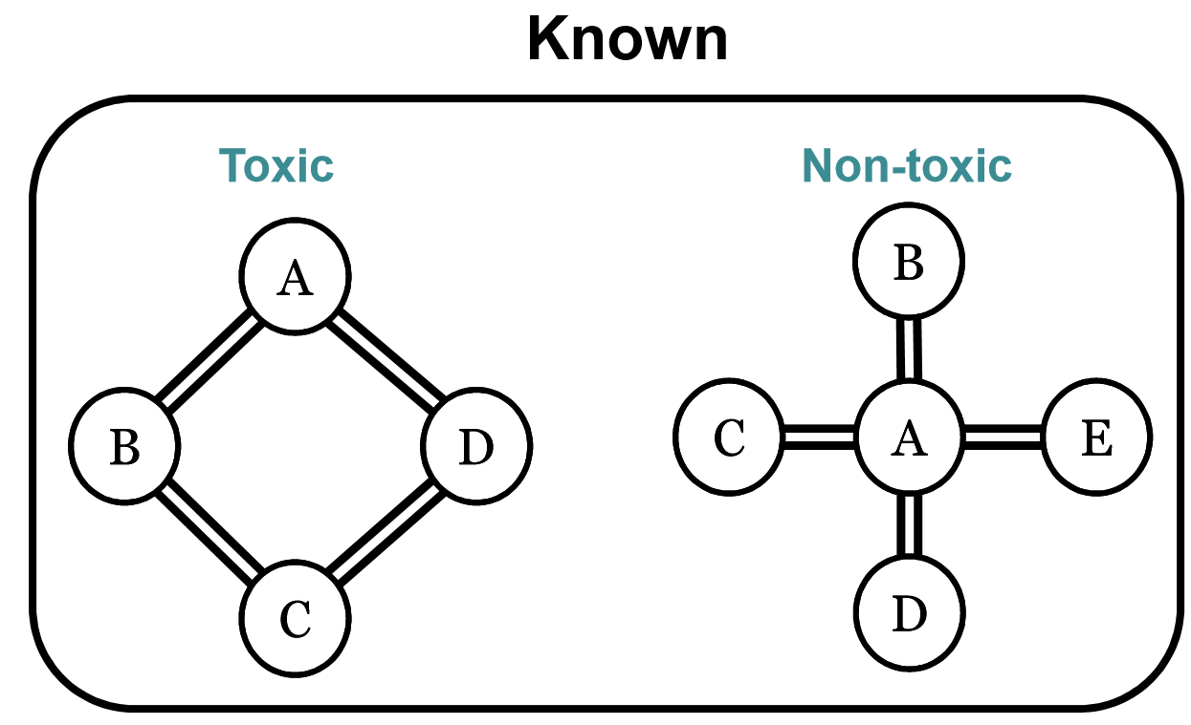
Example: Graph Classification
Task: predict whether molecules are toxic, given set of known examples for training

Slide 15
Why Graphs are Difficult
Modern deep learning toolbox is designed for simple sequences or grids.
CNNs for fixed-size images/grids….
RNNs or word2vec for text/sequences…

Slide 16
Why Graphs are Difficult
But networks are far more complex!
Complex topographical structure(i.e., no spatial locality like grids)
No fixed node ordering or reference point (i.e., the isomorphism problem)
Often dynamic and have multimodal features.

Slide 17
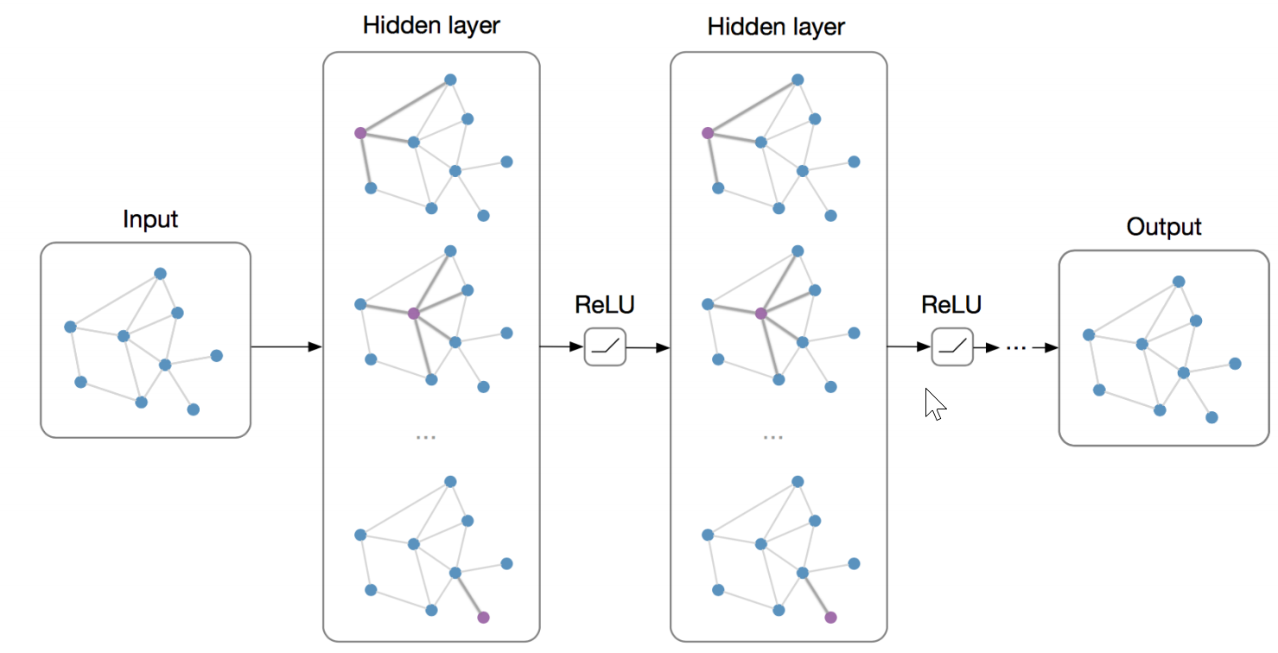
GNN: Big Pictures
Main Idea:
step 1. local message passing: exchange/pass massages between (neighboring) nodes
Why? Because it is supposed to improve the representation of the node (or edge) level
Step 2. global aggregation: summarize the local information when necessary
convolution

Slide 18
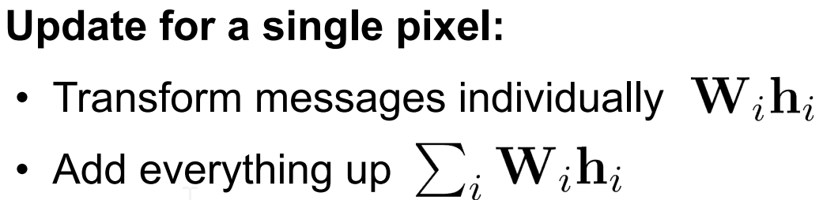
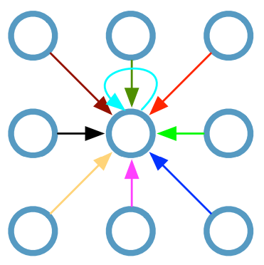

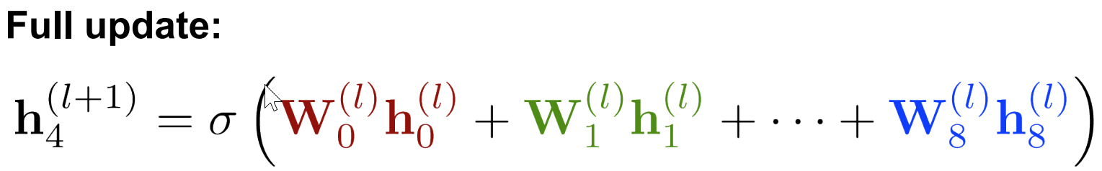
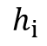
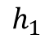
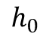
From CNN to GNN
Single CNN layer with 3x3 filter:
$$h_{0}$$
$$h_{1}$$
$$h_{i}$$

Slide 19
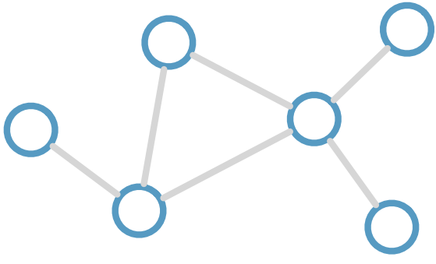
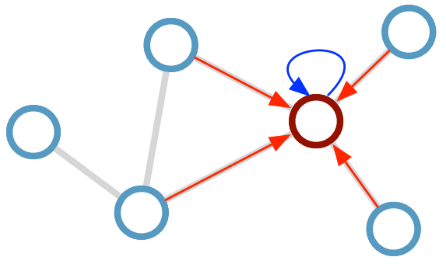
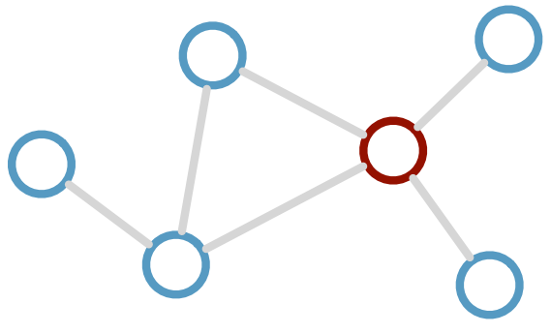
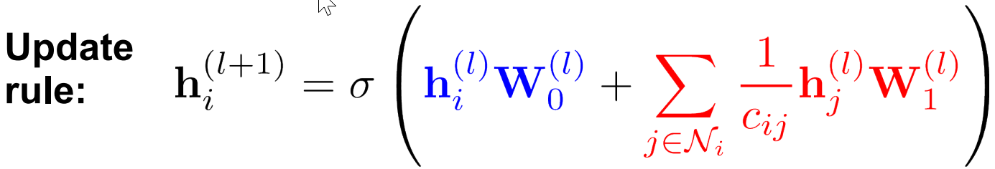
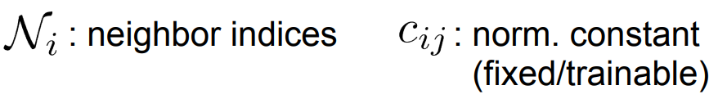
Graph Convolutional Networks
Kipf & Welling (ICLR 2017), related previous works by Duvenaud et al. (NIPS 2015) and Li et al. (ICLR 2016)
Consider the undirected graph:
Compute/update feature for red node:
Desirable properties:
Weight sharing over all locations
Invariance to permutations
Linear complexity O(E)
Applicable both in transductive and inductive settings
Limitations:
Can oversmooth
Only indirect support for edge feature

Slide 20

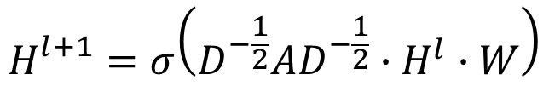
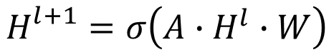
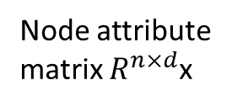
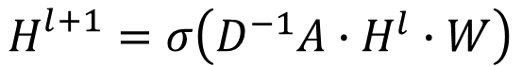
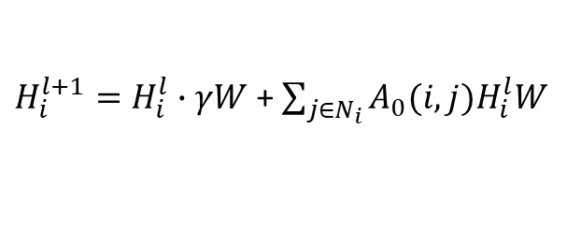

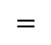
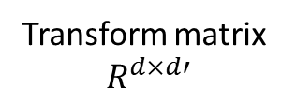
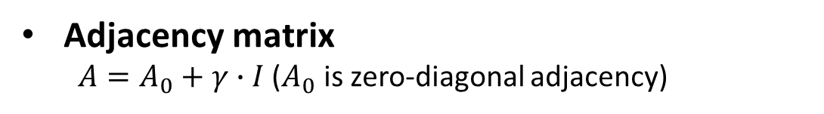


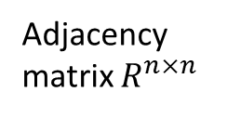
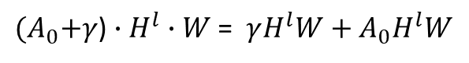
Variations in Message Passing
Variations in the local convolution
Node attribute
matrix $R^{n×d}$x
$$H_{}^{l+1}=σ\left(A∙H^{l}∙W\right)$$
$$H^{l}$$
Transform matrix
$$R^{d×d′}$$
$$H^{l}$$
$$A$$
$$W$$
$$=$$
$$H_{}^{l+1}=σ\left(D^{−1}A∙H^{l}∙W\right)$$
Adjacency
matrix $R^{n×n}$
$$H_{}^{l+1}=σ\left(D^{−\frac{1}{2}}AD^{−\frac{1}{2}}∙H^{l}∙W\right)$$
Adjacency matrix
$A=A_{0}+γ∙I$ ($A_{0}$ is zero-diagonal adjacency)
${(A}_{0}+γ$) $∙H^{l}∙W$= $γH^{l}W+A_{0}H^{l}W$
$H_{i}^{l+1}=H_{i}^{l}∙γW$ + $\sum_{j∈N_{i}}{A_{0}(i,j)H_{i}^{l}W}$

Slide 21
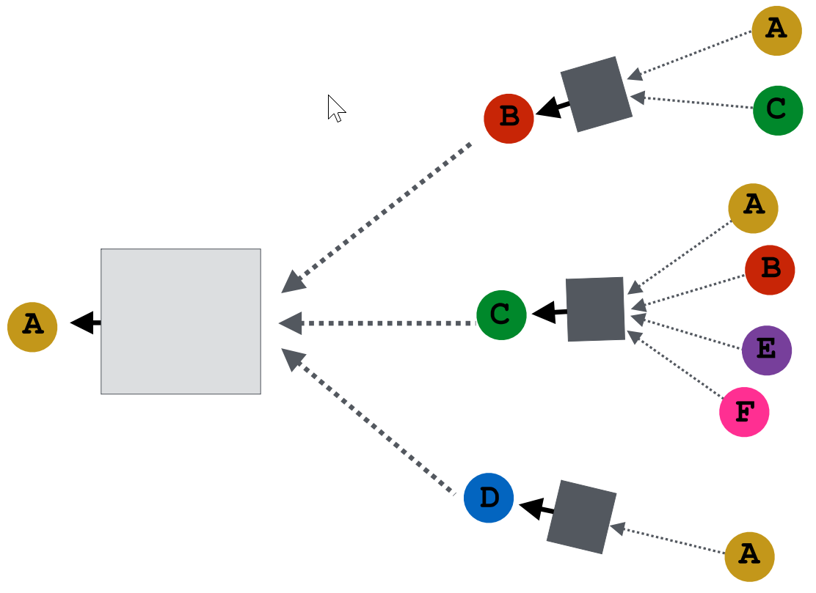
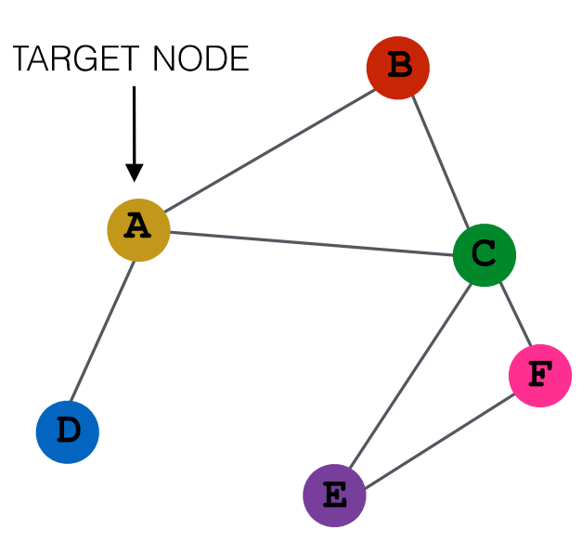
Recursive Message Passing
How to achieve message passing with higher order neighbors?
For each node, do the same thing: aggregate
Then, recursively aggregate based on graph structure

Slide 22
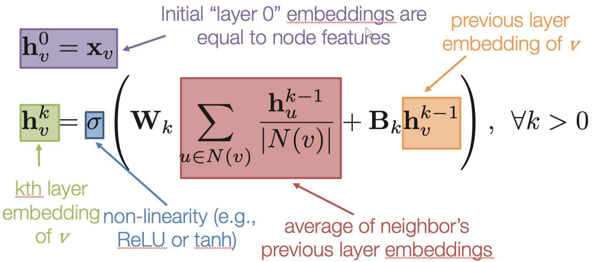
Variations in Message Passing
One format of recursive passing
A two-layer GCN

Slide 23
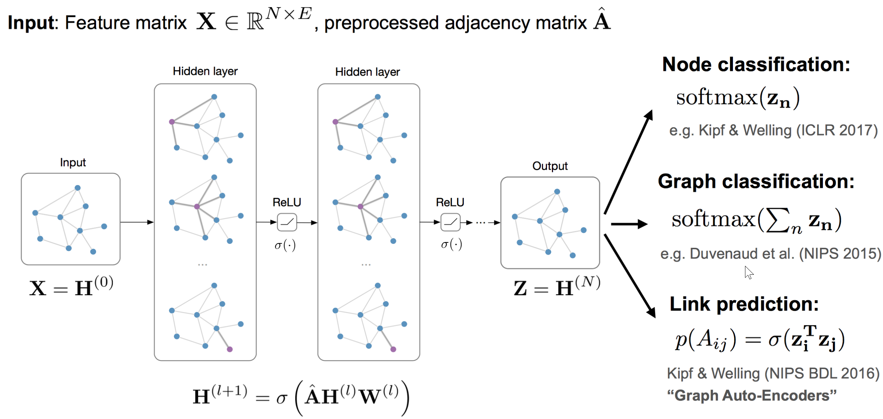
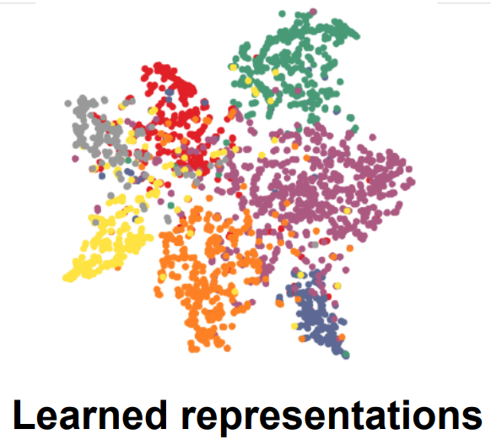
Global picture for different learning tasks

Slide 24
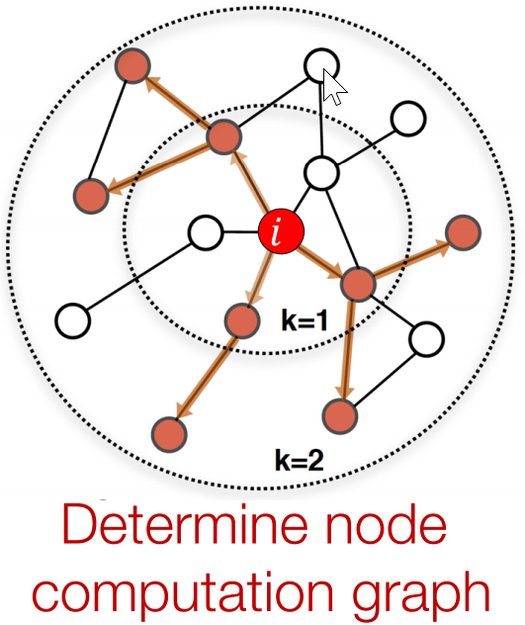
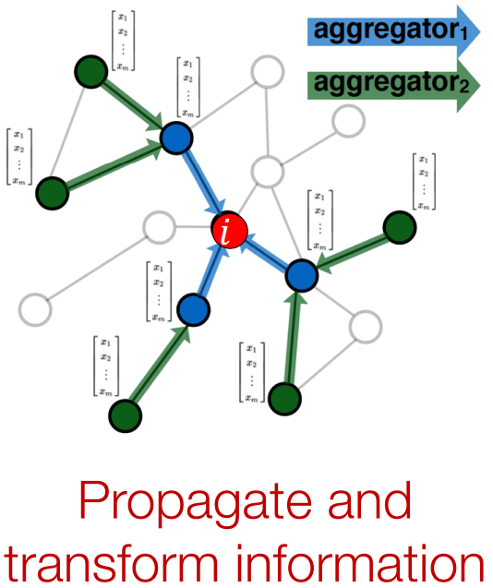
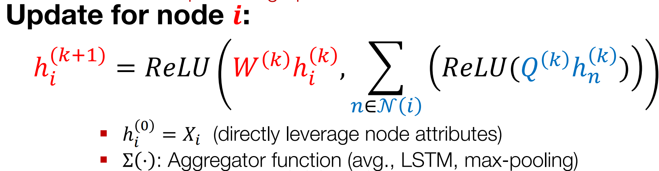
Graph-SAGE Algorithm
Idea: Node’s neighborhood defines a computation graph
Learn how to propagate information across the graph to compute node features

Slide 25
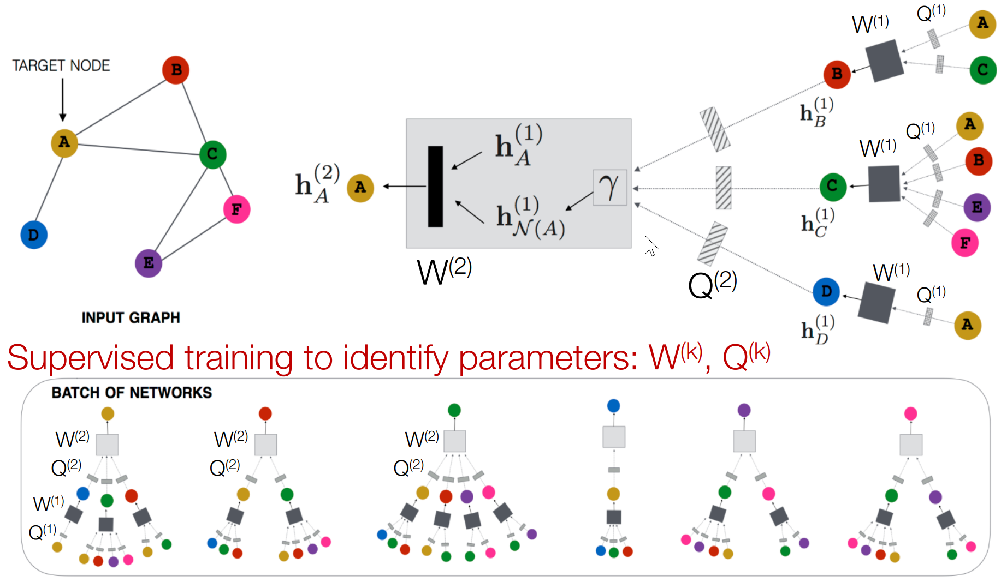
Graph-SAGE Algorithm

Slide 26
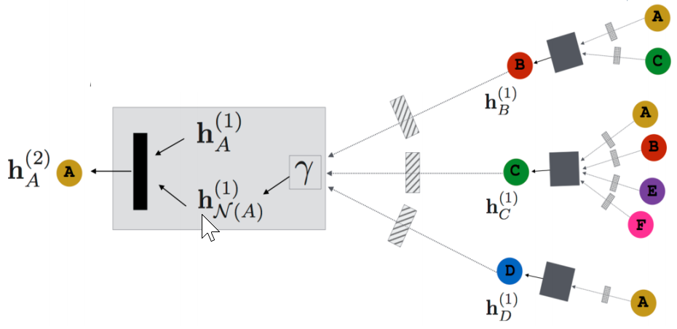
Graph-SAGE Algorithm
Different aggregators can be used
Mean (simple element-wise mean), LSTM (to a random order of nodes), Max-pooling (element-wise max)
Can use different loss functions
Cross entropy, Hinge loss, ranking loss
Model has a constant number of parameters
Fast scalable inference
Can be applied to any node in any network

Slide 27
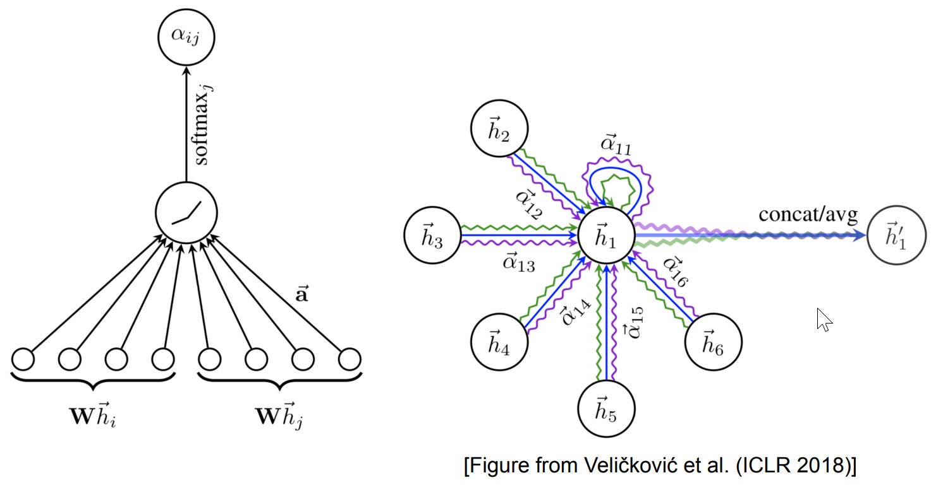
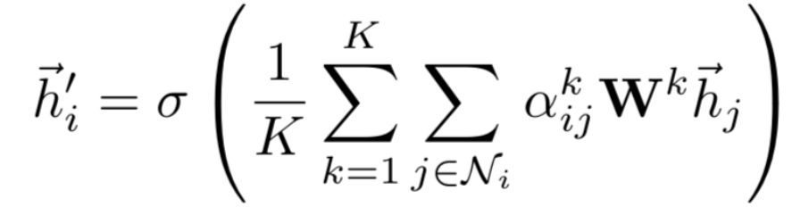
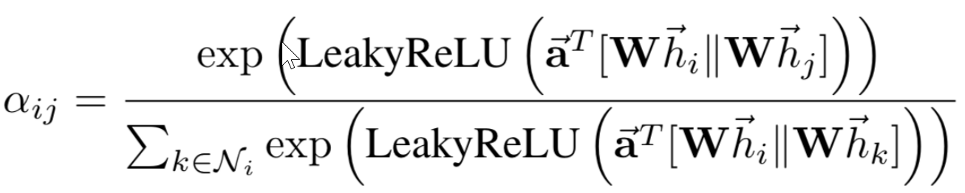
Graph Attention Network
Monti et al. (CVPR 2017), Hoshen (NIPS 2017), Veličković et al. (ICLR 2018)
Pros:
No need to store intermediate edge-based activation vectors (when using dot-product attn.)
Slower than GCNs but faster than GNNs with edge embeddings
Cons:
Attention mainly using content features, does not fully consider structure
Over-smoothing: when larger neighborhood attention is considered, accuracy drops!

Slide 28
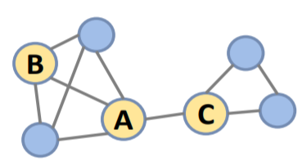
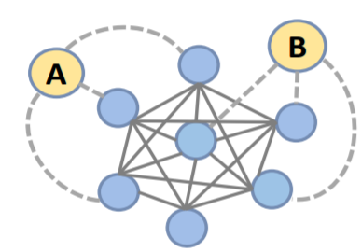

Structural Attention
How to incorporate detailed structural information in the design of node attention?
Combine content and structure together
How to solve the over-smoothing in GAT, or GNN in general?
Extract informative structural clues
Density peaks signify clusters (and boundaries)
Meanshift, low-density separation, Ncut
Contextualize each node with neighbors
Structural fingerprint
(a)
(b)
Common neighbors
Belong to the same community
Mean shift: Comaniciu et al. PAMI 2002

Slide 29


Adaptive structural fingerprint
Structural fingerprint: contextualize each node with its neighbors
For each node i, use DFS to locate a local sub-graph (e.g., 3-hops)
Each node in the fingerprint assigned a weight: importance in shaping the fingerprint (centered around node i)
Weights of the fingerprint
Gaussian or nonparametric decay (isotropic)
$W_{i}\left[j\right]=exp\left(−\frac{{dis(i,j)}^{2}}{2h^{2}}\right)$
Random walk with Restart (RWR, anisotropic)
$W_{i}={\left(I−c⋅{\tilde{E}}_{i}\right)}^{−1}e_{i}$
Shortest-path-distance between node i and j
Start probability (one-hot vector)
Restart probability
Adjacency matrix of fingerprint

Slide 30



Adaptive structural fingerprint
RWR-based fingerprint weights well reflect ``density’’ of connections;
Act as an ``community attractor” when used to compute attention scores between nodes

Slide 31




Adaptive structural fingerprint
Content similarity between node i and j,
Structural interaction between (fingerprints) of node i and j,
Combine content and structural similarities,
$${\text{e}}_{\text{ij}}{\text{=}\text{A}}_{\text{fea}}\left({\text{Wh}}_{\text{i}}{\text{,}\text{Wh}}_{\text{j}}\right)$$
$$s_{\text{ij}}{\text{=}\text{A}}_{str}\left(F_{\text{i}}{\text{,}\text{F}}_{\text{j}}\right)$$
$$a_{\text{ij}}\text{=}\frac{α\left({\overline{e}}_{ij}\right){\overline{e}}_{ij}+β\left({\overline{\text{s}}}_{ij}\right){\overline{s}}_{ij}}{α\left({\overline{e}}_{ij}\right)+β\left({\overline{\text{s}}}_{ij}\right)}$$

Slide 32

Brief History of GNN

Slide 33

Graph Comparison

Slide 34

Graph Isomorphism
Graph isomorphism
Find a mapping f of the vertices of G1 to the vertices of G2 such that G1 and G2 are identical; i.e. (x,y) is an edge of G1 iff (f(x),f(y)) is an edge of G2. Then f is an isomorphism, and G1 and G2 are called isomorphic!
No polynomial-time algorithm is known for graph isomorphism !
Neither is it known to be NP-complete
Though Experiment
First, build a graph A of 1000 nodes, with say 100 colors of the nodes
Then, define a random permutation of the node colors from ${\left\{1,2,…,100\right\}→\{π}_{\left(1\right), }π_{\left(1\right), …, }π_{(100) }\}$
Apply the color transform to change graph A to graph B
Is it easy to tell the isomorphism between A and B?

Slide 35

WL-test
Weisfeiler-Leman test: a simple color refinement method to test isomorphism
Whether two nodes are the same?
Do they have the same attribute?
If Yes, can we say they are the same? – No.
Do they have the same neighbors?
If yes, can we say the two nodes are the same? – No
We need to look into the neighbors neighbors…
Repeat until

Slide 36

WL-Test
Illustration

Slide 37


WL vs GNN
WL and GNN have very close connections
Both need to examine the neighbors of each node
WL: who are my neighbors?
GNN: what are the aggregated feature of my neighbors?
GNN not so powerful as WL
Hash function is injective
And so more ``accurate’’ than feed-forward nonlinear transforms in terms of graph isomorphism
F: collect neighbor nodes and store their features

Slide 38
WL Limitations
Not end-to-end, cannot optimize
E.g. what if only certain sub-graphs are useful for prediction
Hash function may not properly reflect the similarity between sub-graphs
It may overfit the graph structures
Graph-isomorphism is different from graph classification

